Slide 1

Result
Name: Qiyao Zhou
Zid: z5379852

Slide 2

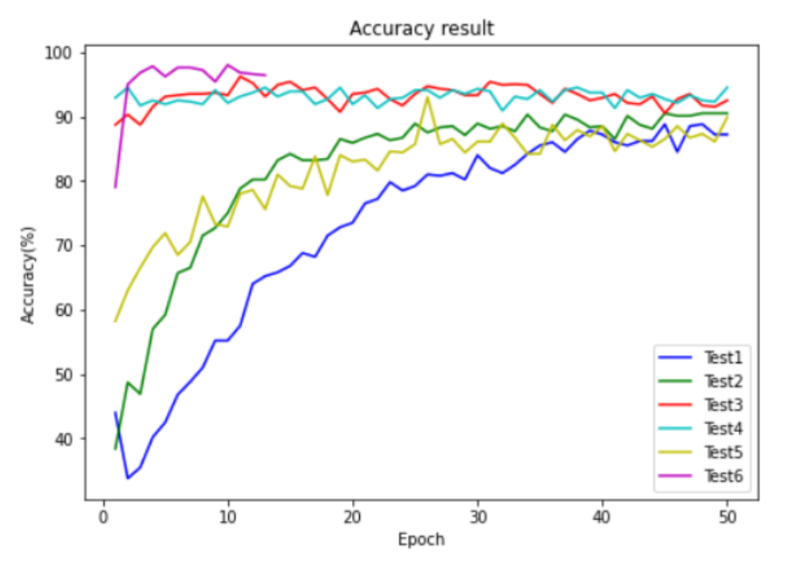
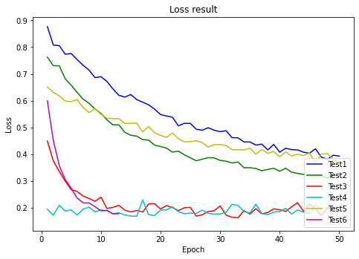
4
Result
-
UNSW

Slide 3

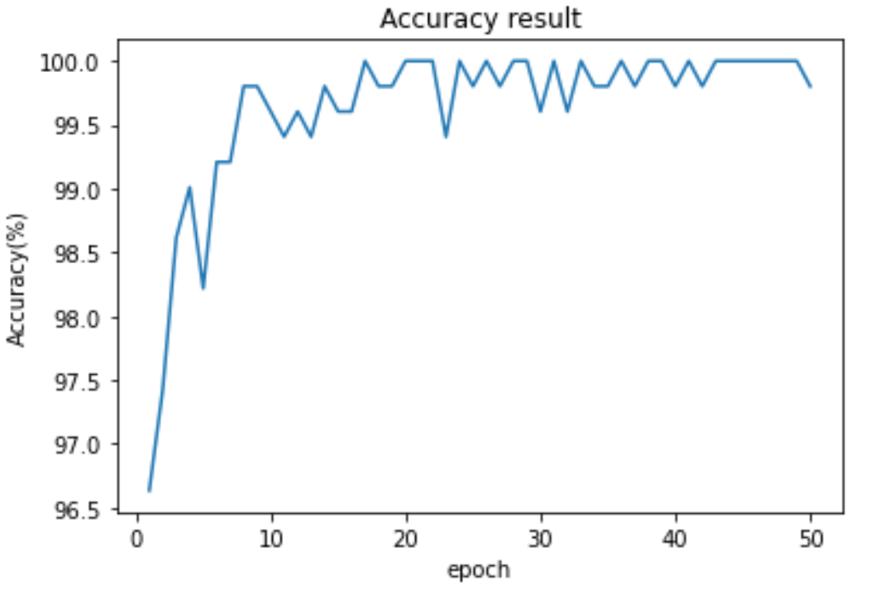
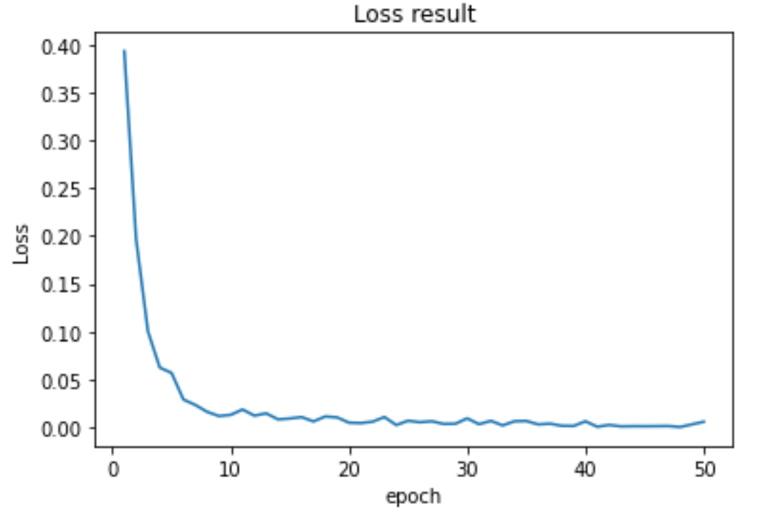
4
Result
-
UNSW

